Slide 1

CK Calorie Tracker
Tutorial by:
Karamdip Binning

Slide 2
Application Overview
Keep track of BMI (Body Mass Index)
Keep track of Daily Calorie Intake needed to maintain current weight
Calculate distance travelled
Calculate calories burnt during activity
CK Calorie Tracker

Slide 3

The Goal
Help user lose or maintain healthy weight
Make user attain a better understanding on the activity they are doing—distance travelled, calories burnt
Application has to be simple, and designed for any person to use
CK Calorie Tracker

Slide 4
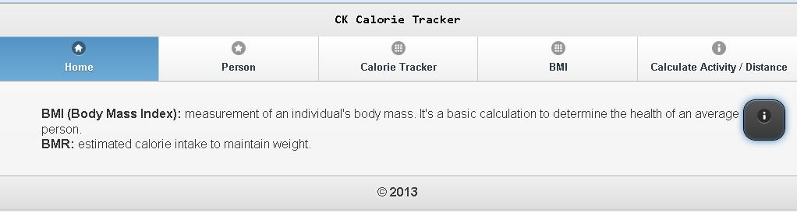
The Home Page
Sleek user interface with functional menu, designed using jQuery
About Us button (i) gives application information such as name and author
CK Calorie Tracker

Slide 5
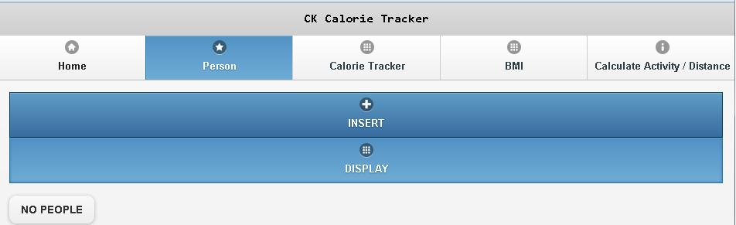
Person Page
User can Insert Person so user can easily keep track of health and calories, instead of having to enter information every time
CK Calorie Tracker

Slide 6
How to Insert Person
Click on PERSON in navigation bar
Person page displays
Click on INSERT button to create new person
CK Calorie Tracker

Slide 7
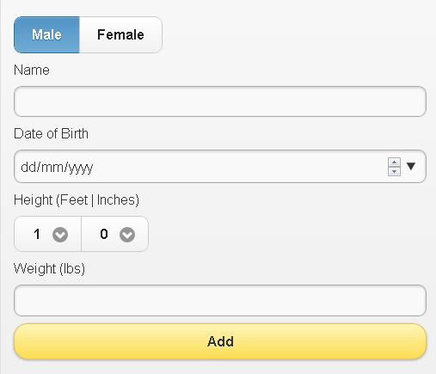
How to Insert Person (Cont’d)
FIELDS
Name
User’s name
Date of Birth
The birth day, birth month, and birth year of user
Height
Feet and Inches of user
Weight
User’s weight in pounds
CK Calorie Tracker

Slide 8
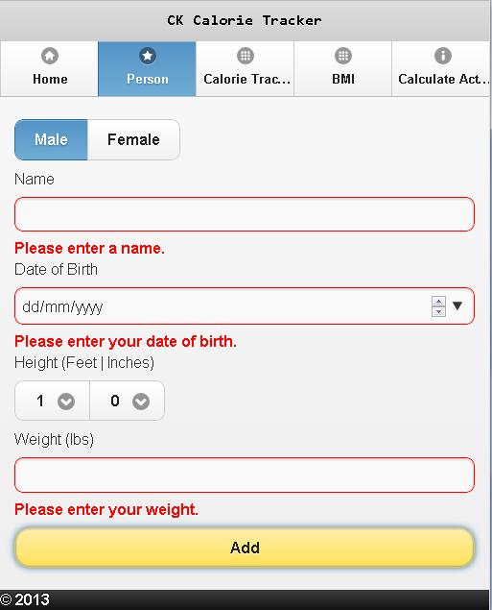
How to Insert Person (Cont’d)
VALIDATIONS
Name
Required
Greater than 1 character and less than 26 characters in length
Date of Birth
Required
Date format (dd/mm/yyyy)
CK Calorie Tracker

Slide 9
How to Insert Person (Cont’d)
VALIDATIONS (Cont’d)
Height
Required
Weight
Required
Must be number
Greater than 0 pounds
Gender
Required
CK Calorie Tracker

Slide 10
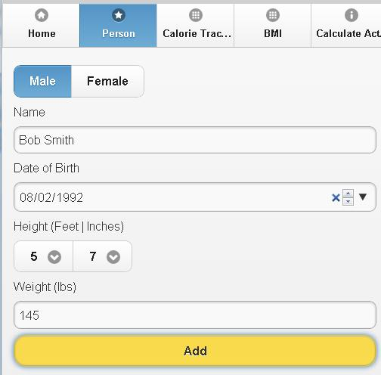
How to Insert Person (Cont’d)
Enter all required information into the fields and select options by clicking
Click “Add” button to create person
CK Calorie Tracker

Slide 11
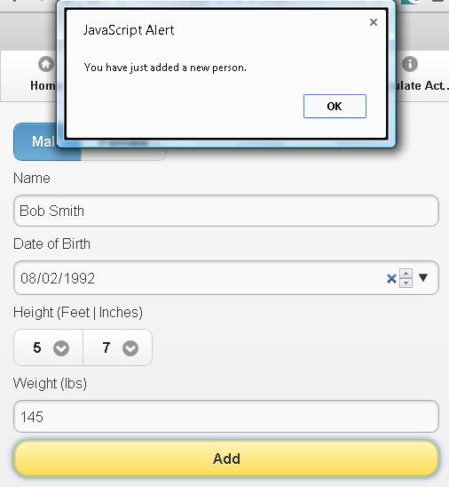
How to Insert Person (Cont’d)
Person is created!
CK Calorie Tracker

Slide 12
How to Sign in as Person
SIGN IN FEATURES
User can Update, Delete user & user information!
Easily Calculate BMI or Calculate Calorie Intake just by one click of a button!
User can calculate calories burnt by activity while doing activity!
CK Calorie Tracker

Slide 13
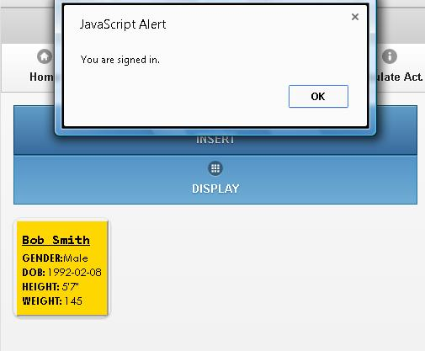
How to Sign in as Person (Cont’d)
Click on Person navigation bar
Person page displays
Click on “DISPLAY” button to show all users
Click on desired Person button that displayed
User is now signed in!
CK Calorie Tracker

Slide 14
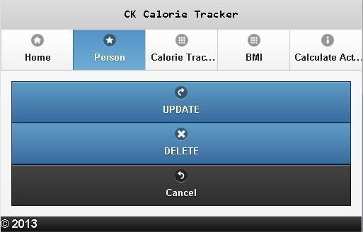
How to Update Person
Sign in as desired person
Alter Person page displays
Click on “UPDATE” button
CK Calorie Tracker

Slide 15
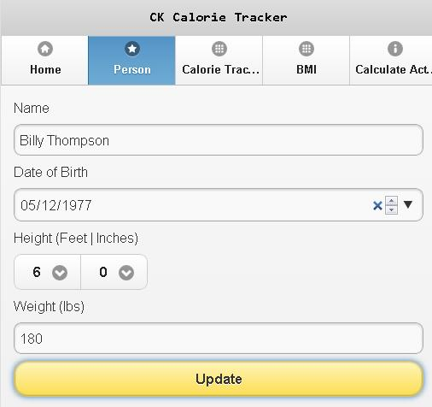
How to Update Person (Cont’d)
Update Person page displays
All data of Person is already displayed in the fields
NOTE: All fields are validated and required
Enter / Select changes
Click on “Update” button to update Person
CK Calorie Tracker

Slide 16
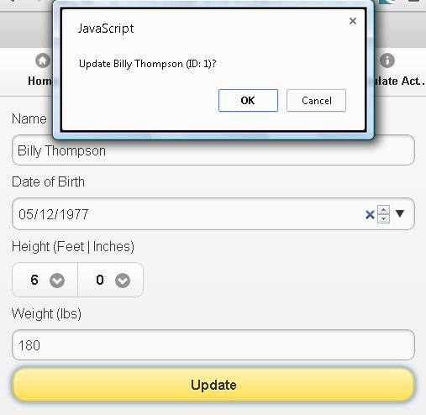
How to Update Person (Cont’d)
Click on OK to confirm updating
CK Calorie Tracker

Slide 17
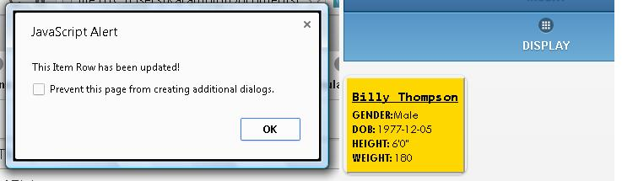
How to Update Person (Cont’d)
Person is updated!
CK Calorie Tracker

Slide 18
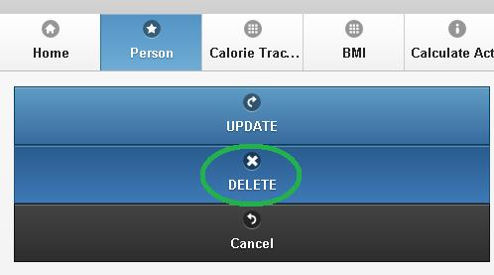
How to Delete Person
Go to Person page
Click on DISPLAY button to show all Persons
Click on desired Person to delete
Alter Person page displays
Click on DELETE button
CK Calorie Tracker

Slide 19
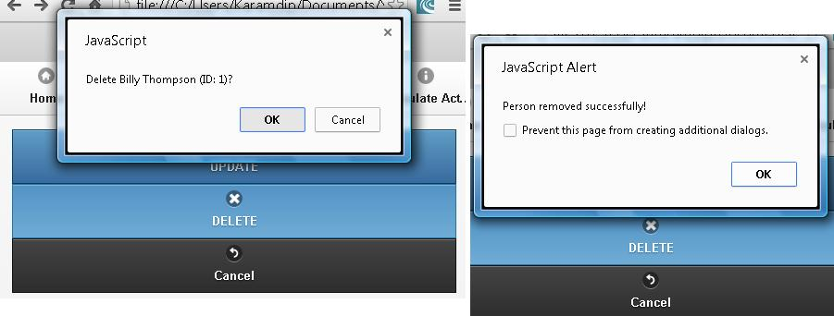
How to Delete Person (Cont’d)
Confirmation to delete user will pop up, click on OK to delete Person
Person is deleted!
CK Calorie Tracker

Slide 20
What is BMI
Body Mass Index: measurement of an individual's body mass. It's a basic calculation to determine the health of an average person
CK Calorie Tracker

Slide 21
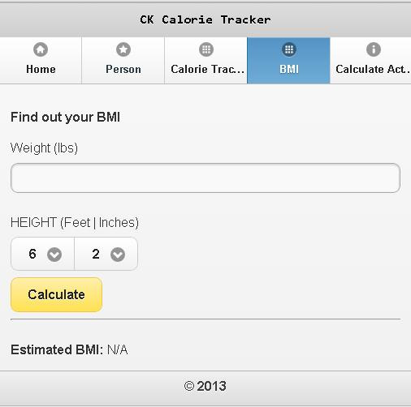
Calculate BMI
NOTE: It is optional for user to sign in
Click on BMI in navigation bar
BMI page displays
CK Calorie Tracker

Slide 22
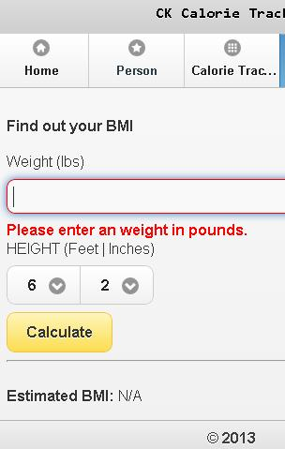
Calculate BMI (Cont’d)
VALIDATION
Weight
Required
Must be number
Must be greater than 0
CK Calorie Tracker

Slide 23
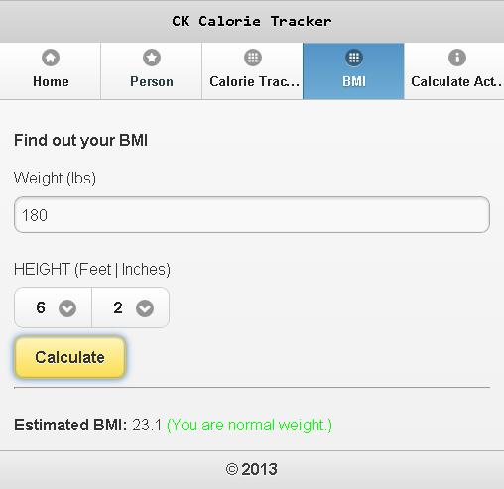
Calculate BMI (Cont’d)
Input weight
Select height—feet and inches
Click “Calculate” button
Estimated BMI is displayed
CK Calorie Tracker

Slide 24
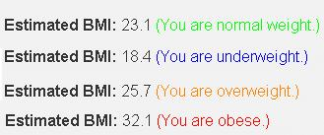
Calculate BMI (Cont’d)
The Estimated BMI also calculates if you are healthy according to your weight and height
NOTE: BMI does not consider muscle mass, therefore may not be accurate to people with great muscle percentage
CK Calorie Tracker

Slide 25
What is Daily Calorie Intake
Daily Calorie Intake: calories needed to maintain current weight
CK Calorie Tracker

Slide 26
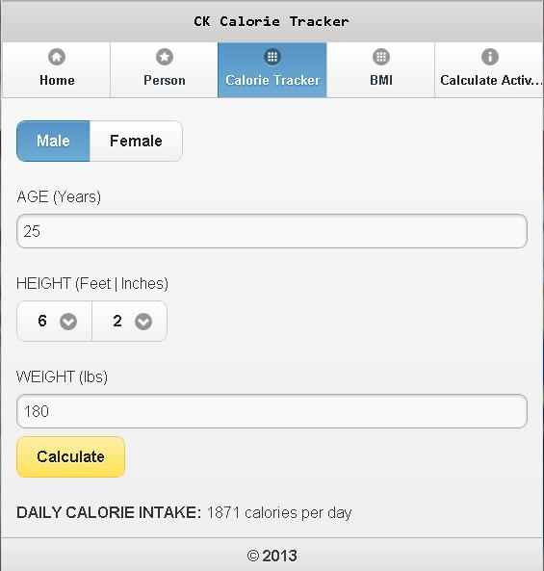
Calculate Daily Calorie Intake
Click on Calorie Tracker in navigation bar
NOTE: It is optional to be signed in to use this feature
CK Calorie Tracker

Slide 27
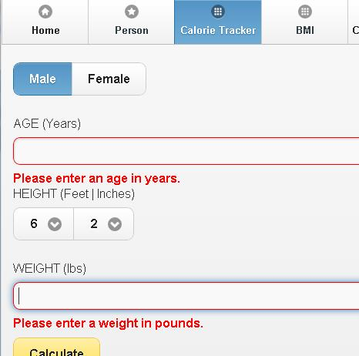
Calculate Daily Calorie Intake (Cont’d)
VALIDATIONS
Age
Required
Must be number greater than 0
Weight
Required
Must be number greater than 0
CK Calorie Tracker

Slide 28
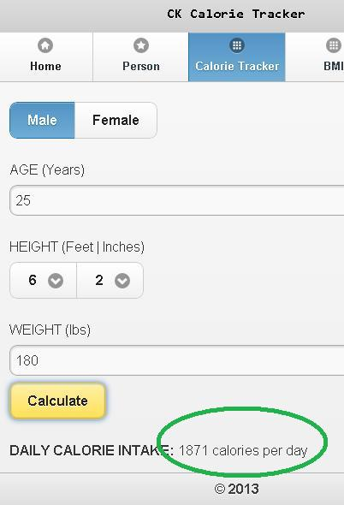
Calculate Daily Calorie Intake (Cont’d)
Input and select all fields
Click on “Calculate” button
Daily Calorie Intake is displayed
CK Calorie Tracker

Slide 29
How Does Calculate Calories Burnt Work?
User must be signed in
User selects activity, different activities results in different effort and calorie burning
User starts activity
Application starts timer and then calculates calories burnt during this activity
Calories burnt depends on Person’s age, weight, height, activity, and time
CK Calorie Tracker

Slide 30
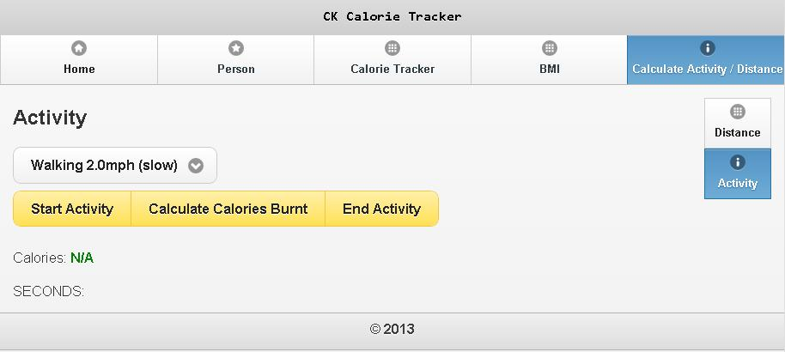
Calculate Calories Burnt
Sign in as desired Person
Click on “Calculate Activity / Distance” navigation bar
Activity Page displays
CK Calorie Tracker

Slide 31
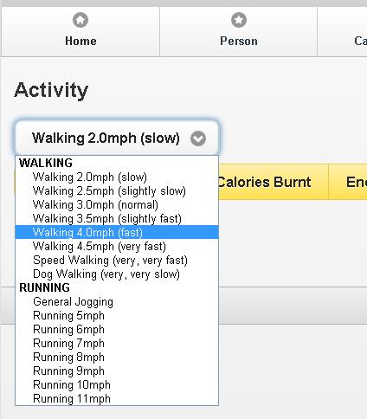
Calculate Calories Burnt (Cont’d)
Select activity
CK Calorie Tracker

Slide 32
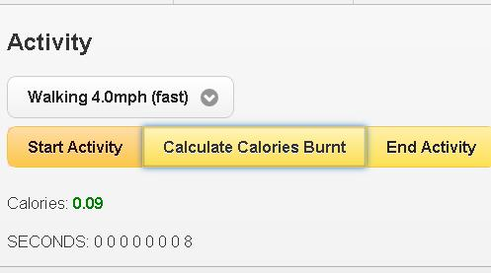
Calculate Calories Burnt (Cont’d)
Click on “Start Activity” button
Timer starts
Click on “Calculate Calories Burnt” button during or after activity
NOTE: You cannot switch activity after starting activity
CK Calorie Tracker

Slide 33
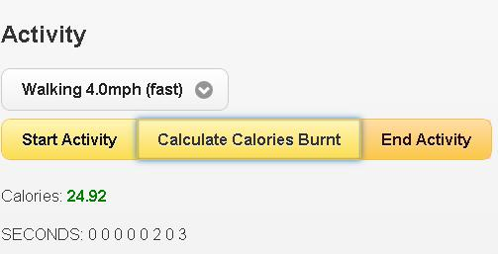
Calculate Calories Burnt (Cont’d)
Click on “End Activity” button to end session
Timer stops
Click on “Calculate Calories Burnt” button to display total calories burnt
NOTE: This feature gets an estimate of calories burnt
CK Calorie Tracker

Slide 34
What is Calculate Distance?
App gets user’s current coordinates—latitude and longitude (POINT A)
App gets user’s current coordinates again once user requests action (POINT B)
Distance (metres) are calculates between the 2 points to see how far the user has travelled
NOTE: This feature calculates a straight (closest) distance from Point A to Point B. Request current coordinates whenever turning and changing direction

Slide 35
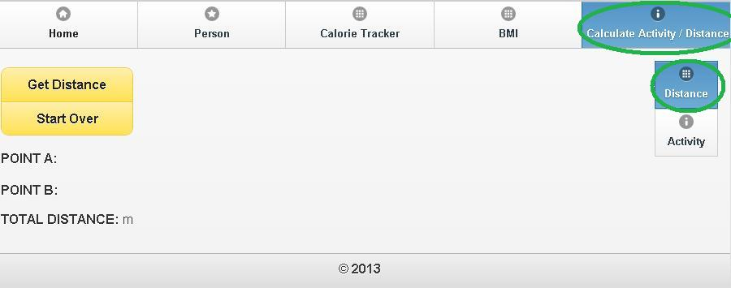
Calculate Distance
Click on “Calculate Activity / Distance” navigation bar
Click on “Distance” sub-menu
Distance page displays
CK Calorie Tracker

Slide 36
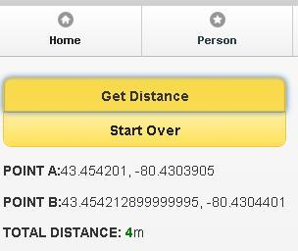
Calculate Distance (Cont’d)
Click on “Get Distance” button to retrieve your current coordinates
Once you want to find out how many metres you travelled, click on “Get Distance” button again
Total Distance is calculated everytime user clicks on “Get Distance” button
CK Calorie Tracker

Slide 37
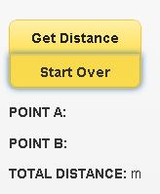
Calculate Distance (Cont’d)
Click on “Start Over” button to clear all data and coordinates
This is so user can start again with his or her walking or running activities
CK Calorie Tracker

Slide 38
F.A.Q.
Is this app free?
Yes!
Does gender matter in the calculations?
DAILY CALORIE INTAKE: Yes
BMI: No
CALCULATE CALORIES BURNT: Yes
If I do not want to display where I am on GPS, can I still use this app?
Yes, but you will not be able to use Calculate Distance feature
CK Calorie Tracker

Slide 39

Enjoy the App!
CK Calorie Tracker

